Slide 1
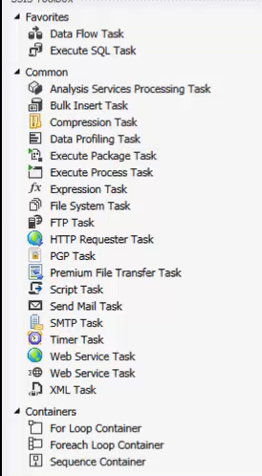
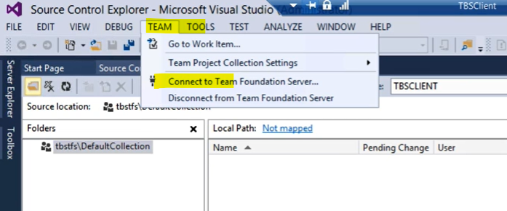
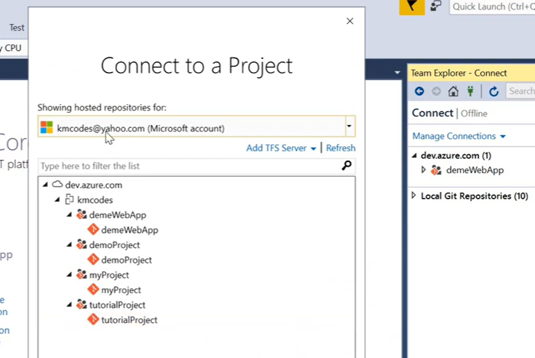
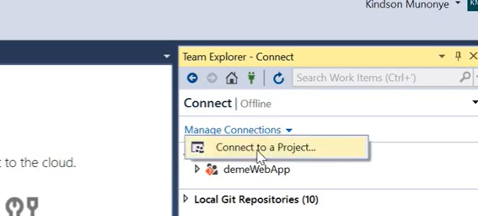
SSIS and SSAS Essentials

Slide 2
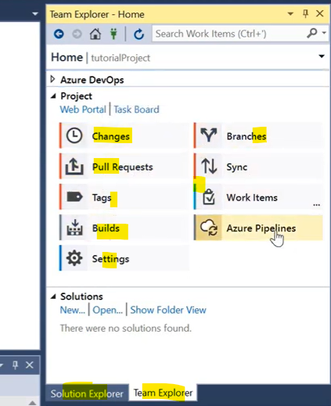

Slide 3
Ssis most used Activities
Data flow task → Source and destination definition , tranformations using derived column, lookup , conditonal splts, variables
Execute Sql task → Write some message (error) to a slq db for anlyze, insert and update log tabe , run complex sql , SP
Bulk insert task (csv to sql) → Copy very fast last csc to sql server , juste configure the source and destination well
Exceute package task → this help execute several packages in sequence using forEach loop, SSIS_pakage tables (list of package to run having flag 1 or 0, and in a given order.
Expression task → is used in the controle flow to define some expression like file path, file name, make some comparaison , before running some task using precedente constrain edit (If this experssion value is a given value (nomber , file , any value) the next step will be the run of a given task.
File system task → This use to copy , move , delete in a directory, after processing a file , you can move or delete files it using this task
SSAS processing task → If you have some ssas cube , this task help to process those SSAS to update the data
Script task → To find a file path and file name or extenssion and send this info for processing in the data flow or bulk insert , using readOnly variable and write variable , API call read json file using class and buffers in c sharp (130 How to read data from api in ssis - YouTube)
Send mail task → This will send notification of the run of specific packge with status succeded or Error, also can be created in the event handler section to send an email with the error message in (best practice)
For loop container → Excetion of a task till a maxtime ,start from intial value , and incremental value
Foreach loop container → loop trough a file directory , select the file one by one , and send the file name to next data flow task (copy , transform)
Sequence container → this will enable sequencial run of the solution block (for the tracability of run)
Deplyoment SSIS package in SSIS catalog
https://www.youtube.com/watch?v=54RsM3L_ljI

Slide 4
Ssis most used data flow task
Source and destination definition sql , csv, excel …. Variables and dynamic file names
Derived columns task to add field using variable value and inbult expression (flag field, replacing value, concatinating string , some math calculations)
Conditional splits task help target a given destination if certain conditions are met (If country = USA then destination tablle Man…)
Look up task help find some value in a reference table correponding to a value to the main table , and copy this id to the main table (Scenario of fcat and dimension table load)
Aggregate transfomation task helps to aggregate your data coming from a files using aggregate function like sum ,min avg…and target an output destination
SCD 1,2 task
This will insert a new row in the target table or update a row in the target table if a reference id or string not exists / exists type1(overwriting)
When there are some changes , an addition row will be added to table . The preview row will be flagged as old (no , date…) and the new one will be flagged as the current one.
Breackpoint : OnPre / OnPosExcution , and see what ‘s happening before and after the execution of task , you can also see the variable value by searching Debug/Windows/local

Slide 5
Ssis Parent and child package
A parent package with some variable that will used by child pacjages (ex. Directory = files folder)
3 child packages that should process data from a given file to a given table based of course on the file name, these packages haves the following variable created :
RunPackage = true/ False
File path = Directory / filename
( dynamicaly getting directory path from parent package using Parent package configution to pass the value the the child package)
A script task from the parent package will check in the derectory to find the files
A Script task from the parent package will check in the directory to find the files
If file exist the RunPackage will be populated with true witch means this package can run, If the fille not found then RunPackage = false (so the package will not run)
https://www.youtube.com/watch?v=v-wOBFEAerU

Slide 6
Ssis parameters vs variable vs expression
Packages got created using some variable (for Source , destination ) , when it’s time to deploy those packages will get Parameters values of the project level using expression , so that at the run time the correct directory and database will be used.
https://www.youtube.com/watch?v=uDEXDDGr_Bs
Par1 = ditectory
Par2 =fileName
Par3 = ServerName
Par4 = DatabaseName
Par5 = TableName
Expression
Expr1: Var1_FilePath = Par1 + Par2
Expr2: Var2_2SqlServer = Par3 \ Par4 \ Par5
Note : variable value can come also from Scrip task

Slide 7
Ssis Error handling
In SSIS you can use error handling set up from data flow or from the controle flow
In data flow , you can enable the error output to move (redirect the bad record to a log table or file for feather analysis , you can use the data viewer to view the record if needed.
In control flow , you can enable the Event handler to track error during the execution of packages . You can create a small tasks (sql and send email )in the event handler section , that will use the system variable at run time like errormessage , packagName, sourceName, start and end time. to write some data in a dedicated log table and send an automatic mail to you (dedicated mail box)

Slide 8
Ssis deployment
When the packages have been developed test and validate , is now time to deploy its on a dedicate server for processing.
Make sure the intergrated SSIS catalog is enable on the target server.
Make sure SSISDB has been create to store all this packages
Inside the SSISDB , create a dedicated folder for your packages
From you SSIS DT project , start the deployment wizard
Find / connect to the target server where SSISDB has been created (DSV, TEST, ACC, PROD)
Browser to the SSISDB/your folder and deploy your packages
Go to the server , drilldown to your package
Create a Job for your packages
Schedule runs for the package
Let the package run
And see the package exceutions

Slide 9
SSAS project setup
On premise tabular Cube
First identify the tables (combination of tables)that will be use as DataSource and create views on top of those.
Create a new ssas project , conncet to the source server , import the newlly cerated views
Create relationship between views ,hierarchy (https://www.youtube.com/watch?v=wXLXUDU4IQc ), create some measure , calculated colulns (based on business needs)
Define some role (RLS, ols)
When done the solution can be deployed to the dedicated analysis server
https://www.youtube.com/watch?v=ccvgw_gEiQY&list=PLy4OcwImJzBLV-PKazKbw82ShgtcWy5E3&index=1
Azure analysis service (AAS)
Create a tabular in Vs (tabular Analysis services) , this will create a model.bim witch includes :
Connection to Data source (mostly azure sql , storage account…)
Measures ; KPIs;perpectives;Relationships;Roles (RLS, OLS..), tables
Deploy and process the model
When model created , it can be deployed to the AAS server
Use a Data factory/Fabric pipeline to process the data in the cube
https://www.youtube.com/watch?v=8LSqp5frjXI and https://www.youtube.com/watch?v=4Fv6cHdL8S0
Afterward third part tool can be use to facilite the manament of the dara like :
Tabular editor v2 (free)
Dax studio

Slide 10
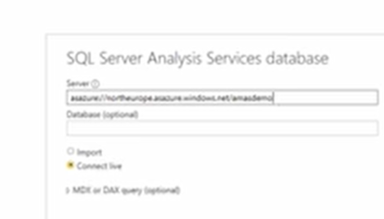
SSAS project Setup
When all data have been impoted in VS model.bim and to AAS (Azure) , to can connect to that model using Power Bi , and there you can
choose for For LiveConnection or Import
LiveConnection : Power BI send query and AAS will calculate
Import : Data will be als store in PBI memory
https://www.youtube.com/watch?v=4Fv6cHdL8S0 (from 20 th min)
SSIS/SSAS/Power BI end to end project : https://www.youtube.com/watch?v=eNxbMwUGl1g&t=3596s
Realtime reporting with PBI report server ,with refesh unig google extention:
https://www.youtube.com/watch?v=yM37Zb5YK7c&list=PLClkz6fOJwPziaxc5At9ylfAoLC87lHSO&index=9

